Slide 1
Route Briefing
Airspeeds are 100 KIAS for all the aircraft in the flight
Configure your navigator to decimal degrees format. DO NOT USE degree, minutes, seconds.
Ensure your datum is WGS 84
Make sure that “lead turn” is turned off. All waypoints are “fly over” waypoints. Ensure that the “distance to” cycles to “0” (zero) before turning to the next point.

Slide 2
Route briefing (con’t)
All turns will be “standard rate” with the waypoint out the left hand side of element lead. Think about when we were students and we practiced “turns about a point”.
I discourage the use of autopilots to fly this arrival
As always, airspeed control is the key to success
Make all airspeed changes in small increments

Slide 3
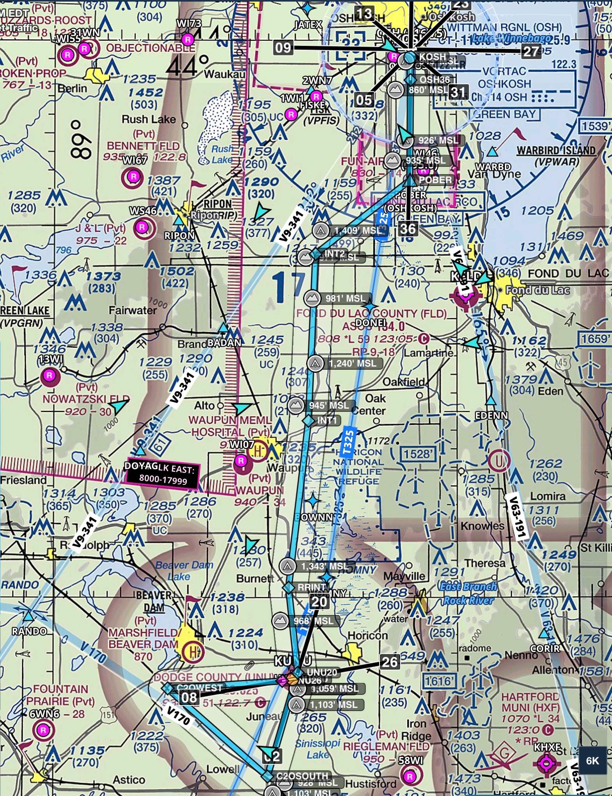

Slide 4
GPS Waypoints
(Decimal Degrees)
From | To | Heading
UNU26 / 43.425N / 88.717W | C2OWEST 43.418N / 88.858W | 270°M
C2OWEST | C2OSOUTH / 43.339N / 88.735W | 135°M
C2OSOUTH | UNU20 / 43.422N / 88.702W | 20°M
UNU20 | RRINT / 43.509N / 88.709W | 357°M
RRINT | INT1 / 43.658N / 88.684W | 10°M
INT1 | INT2 / 43.808N / 88.675W | 6°M
INT2 | POBER (Only waypoint from GPS Database) | 56°M
POBER | OSH36 / 43.964N / 88.557W | 4°M

Slide 5
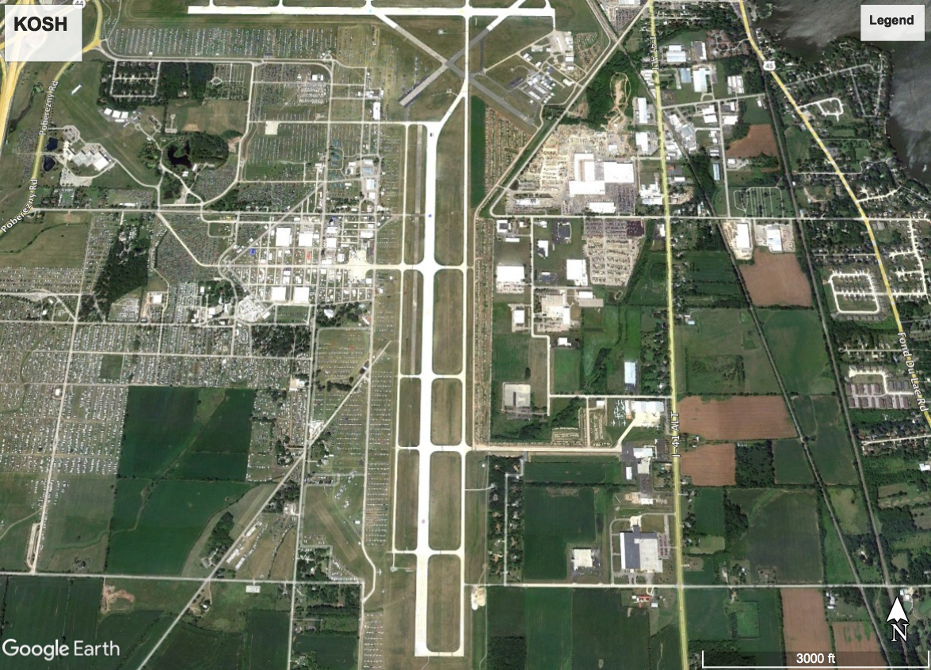
RWY 36L
RWY 36R

Slide 6
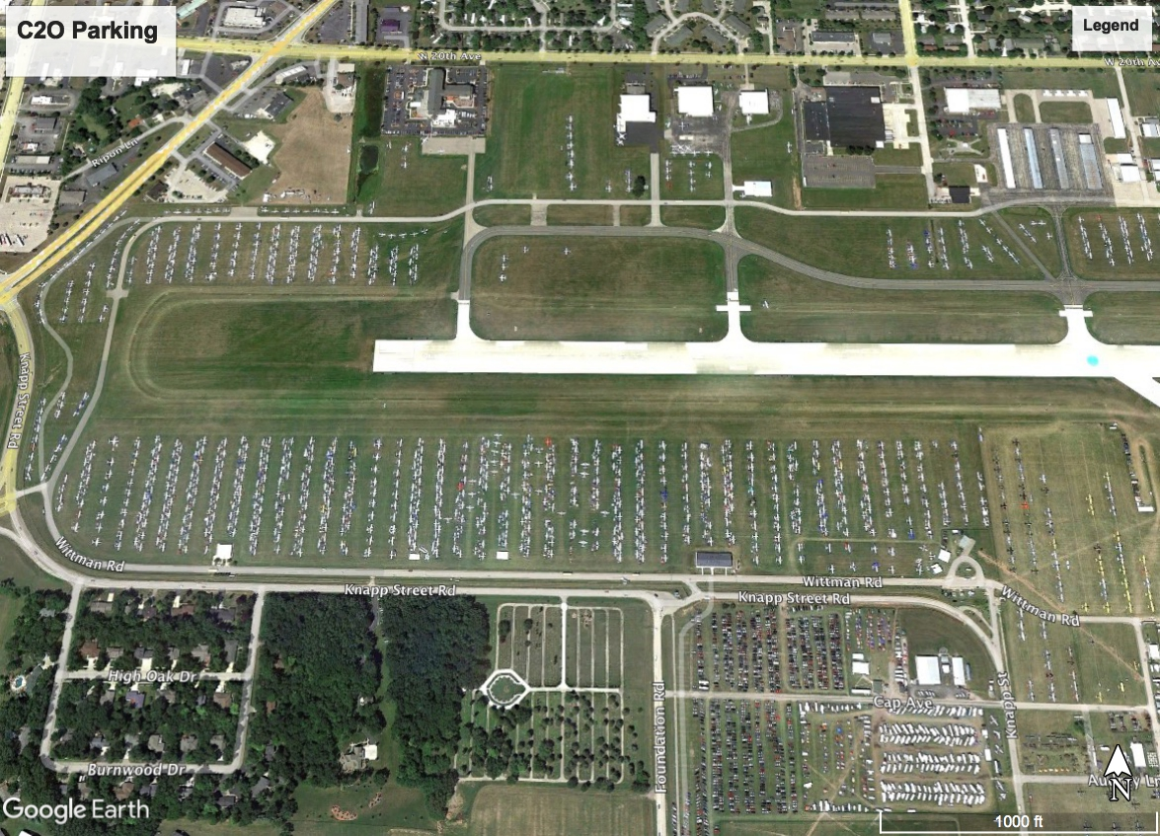
C2O
Basecamp

Slide 7
